Slide 1
Manual Page

Slide 2
The command man is used for reading the command line manual page for a Linux command, configuration file, or any other feature.
Manual pages are usually installed along with the installation of software in Linux.
There is a defined syntax for manual pages, which is parsed by the command.

Slide 3
Let us create a man page for the following bash script I have written:
#!/bin/bash
if [ "$1" == "h" ]; then
echo "Hello"
fi
if [ "$1" = "b" ]; then
echo "Bye"
fi

Slide 4
This script does only two things : It prints “Hello” if option ‘h’ is specified as argument, and it prints “Bye” if option ‘b’ is specified as argument.
Let us create a man page for this program. Use vim or any editor of your choice to create a text file.
nano test.1

Slide 5
The extension ‘.1’ is signifying that this man page is for an executable command. It is not a compulsion but rather a widely followed convention while writing man pages.
The manual page for man (man man !) lists the categories:
1 Executable programs or shell commands
2 System calls (functions provided by the kernel)
3 Library calls (functions within program libraries)
4 Special files (usually found in /dev)

Slide 6
The manual page for man (man man !) lists the categories:
5 File formats and conventions eg /etc/passwd
6 Games
7 Miscellaneous (including macro packages and conventions), e.g.
man(7), groff(7)
8 System administration commands (usually only for root)
9 Kernel routines [Non standard]

Slide 7
A man page is created using the very old roff markup language. It has commands (read markers) for various titles and sections.
.TH – This should be first command in the man file. It is used to specify title heading of the man page.
.SH – Section Heading.
.B – It is used to display the text next to it in bold.
.TP – It is used to display information about an argument (flag) to the command.
.BR – It is used to display text in bold and in the normal Roman font.

Slide 8
nano test.1
.TH test.sh 1
.SH NAME
test.sh \- Print Hello or Bye
.SH SYNOPSIS
.B test.sh

Slide 9
[ h ]
[ b ]
.SH DESCRIPTION
.B test.sh
This is a sample script that does only 2 things. It either prints “Hello” if the argument is ‘h’ or it prints “Bye” if the argument is 'b'

Slide 10
.SH OPTIONS
.TP
.BR h
Print Hello
.TP
.BR b
Print Bye

Slide 11
Test the man page we just created using the command below:
man ./test.1

Slide 12
· Header
· Name
· Synopsis
· Description
· Options
· Files
· See also
· Bugs

Slide 13
Groff Command is used to compile and create the manual page.
TITLE HEADER
We begin with the .TH macro. This macro expects at least five parameters in the order of:
.TH [name of program] [section number] [center footer] [left footer] [center header]

Slide 14
SECTION HEADER
As I explained earlier, the manual pages are divided into sections. These sections are defined with the .SH macro. For instance, the first section is always NAME. .SH requires just one parameter:
.SH [section name]
.SH will always have [ section name] converted to bold lettering. Text written below .SH will be indented. So let us take a look at our current manual page with the .TH and the .SH macros:

Slide 15
FONT ATTRIBUTES
We continue with font attributes. The simplest ones are bold and italics. The macro for bold is .B and the macro for italics is .I. Depending on your system, italic fonts may appear as underlined text instead of actually italicized text. Normal font (no bold or italic), is called Roman. Let us further modify our manual page to look like as follows:
.B = bold
.BI = bold alternating italic
.BR = bold alternating Roman
.I = italic
.IB = italic alternating bold
.IR = italic alternating Roman
.RB = Roman alternating bold
.RI = Roman alternating italic

Slide 16
COMMENTING
As you can see, creating a manual page has suddenly become a little more complicated. Fortunately, like in any programming language, one can comment the source code for the manual page. Comments are prefixed with .", as in:
." This is a comment
It is a good idea to comment your code so if anyone wants to modify it, they will know what it is they are modifying.
groff −Tascii −man myapp.1

Slide 17
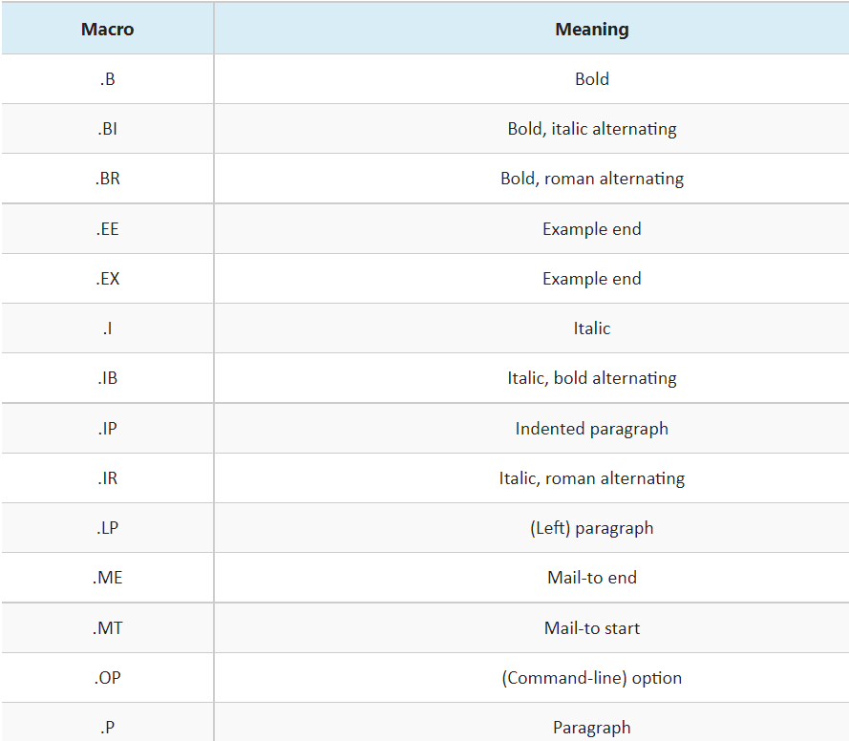

Slide 18
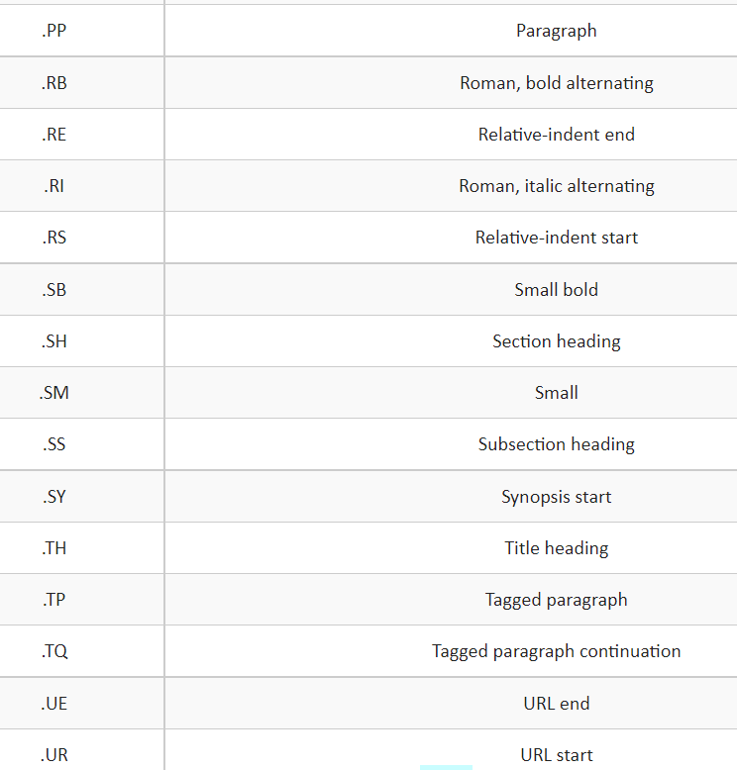

Slide 19
